Slide 1
Gortatole Residential Trip
25th, 26th and 27th April 2018

Slide 2
Objectives of meeting:
To inform parents/guardians about aspects of the Gortatole residential trip
To reassure parents/guardians
To share expectations

Slide 3
Aims of the Trip
To prepare Year 7 pupils for the transition to Post Primary School
To develop confidence and self esteem
To encourage pupils to challenge themselves physically, socially and emotionally in a supportive environment
To develop independence and build life skills
To enhance their problem solving skills

Slide 4
Details
Times
REMEMBER: -
Departing – 9am Wed 25th April
Returning before 4pm on Fri 27th April (TBC via text)
To have a hearty breakfast.
To leave your mobile and electronic devices at HOME!
To dress appropriately.

Slide 5
Staff Members
There will be 5 Gortatole instructors available for the course activities
Damian Gribbin – Course Co-ordinator
Alan Currans
David Scott
Damian Gribbin
Mrs. McBride
Mr. Hannigan
Mrs. Short
Mr. Sweeney
Mrs. Scullion

Slide 6
The Main Building
Dorms

Slide 7
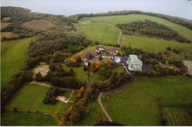
Canteen
Library
Aerial View

Slide 8
Activities
Daytime
Evening
Caving
Canoeing and water confidence
Hillwalking
Climbing wall
Orienteering
Treasure Hunt
Team challenges
Football/Games room

Slide 9
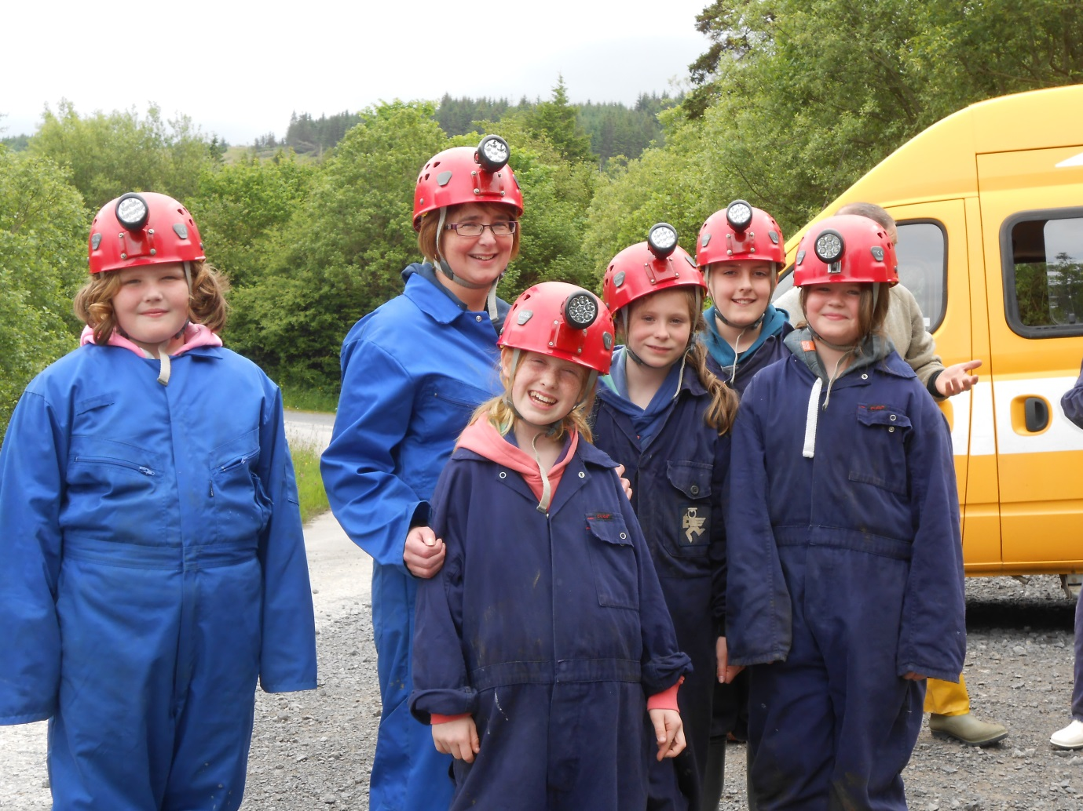
Safety is Paramount
It isn’t about how we look!
IT IS NOT A FASHION SHOW!

Slide 10
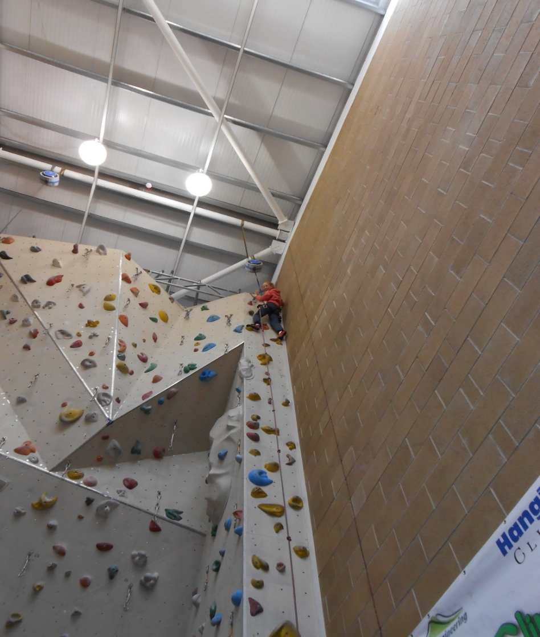
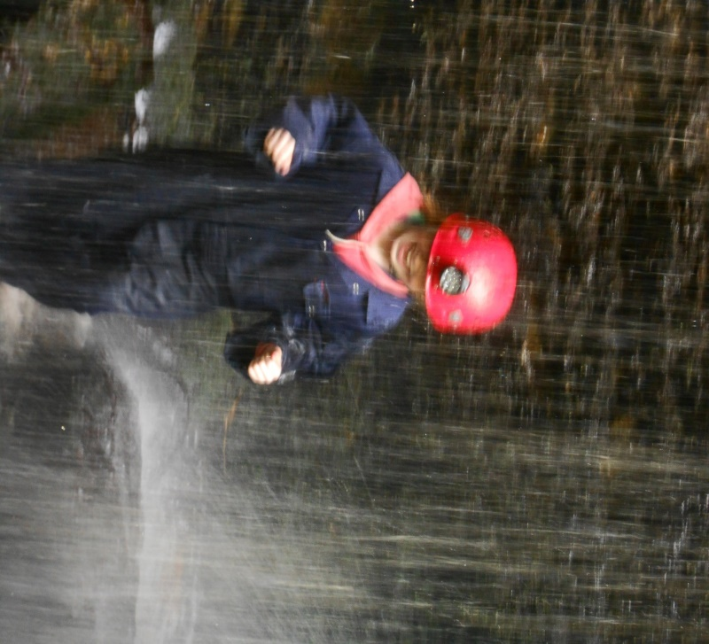

Slide 11
Room Allocation:
Pupils will learn about their room allocation on arrival.
They can choose a number of friends to share with and staff aim to accommodate their requests.
Four per room – Two from each class
Boys will be on one floor and girls on another.
Staff will be in an adjoining room and can be contacted at any time with a buzzer system.
Pupils are advised to only enter their own rooms
Rooms are locked automatically at 12pm. (Pupils may still get out of their room to seek staff or go to the toilet but they cannot enter other rooms)

Slide 12
Centre Duties
Make own bed and put on a duvet cover
Set the table for the next meal
Brush the floor in the dining room and in assigned areas
Pick up litter
Clear out buses after trips
Make supper – toast, juice and biscuits
Mop and clear shower areas
Clean and return own equipment after use

Slide 13
Packing:
Follow the guidelines as outlined in the information sheets for clothing and equipment.
Wellies (named)
Sun hats, sun cream
Medication (labelled and in a clear plastic bag)
Plastic bags
Please make a list of items packed and make sure pupils are involved in packing.
Please put names on towels, swim suits, under armour, etc.

Slide 14
Food
Breakfast – cereal, juice, tea, toast, fruit
Lunch – cooked meal, chocolate bar, juice, fruit
Dinner – Cooked meal, dessert, fruit, salad
Supper – toast, biscuits, juice
All food adheres to the school nut free policy.
Pupils may bring some nut free treats and a bottle for water.
There is one choice at meal times but bread and cereal are always available.

Slide 15
Change:
Bring some loose change in case there is the opportunity to go to the shop.
There will be no tuck shop.

Slide 16
Phones and Electronic Devices:
Mobile phones are not permitted at Gortatole.
There is a pay phone but we prefer pupils not to phone home as this can lead to home sickness.
We have parent contact numbers and we will ring you if we need to.

Slide 17
Code of Conduct:
Pupils will be expected to treat each other, adults and property with respect.
We need to be able to trust pupils.
It is important that pupils listen to the instructions from leaders to ensure their safety.
Bedtime – Staff monitor rooms regularly and ensure pupils are settled for the night. It is important that they get a good night of sleep as they will be up early doing physical activities.

Slide 18
Heading For Home
Before heading home pupils will be expected to:
Pack their bags and check that they have all of their belongings
Tidy their rooms
Strip the beds, bring sheets to the laundry and fold duvets
Take rubbish to the bin
Clear all common areas – shower blocks, dining room, games room, etc.
Return all equipment

Slide 19
Finally……… The child that returns home to you will be a different child to the one you send. Whilst they may be tired and very grumpy, they will also be much more mature, responsible and independent.

